Slide 1
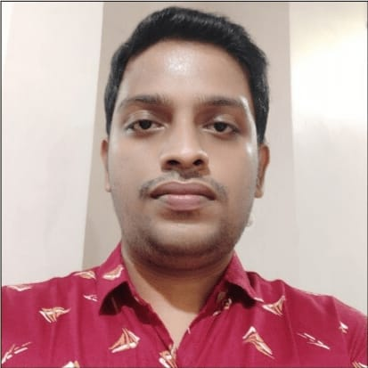



Mahesh M
Bachelor of Engineering, Computer Science and Engineering : 2016 - 2019
Analyst/Software Engineer
Skills
C#​ | C# Basics,OOPS,Generics,​ Collections, Array,Loops,LINQ​
.NET​ | ADO.NET,ASP.NET with MVC5 and WEB API,Entity Framework​
Angular | Databinding, Routing, Forms, Model, CRUD, Events, Validation​
Database​ | Microsoft SQL Server ​
UI Tech​ | HTML 5 & CSS 3,JavaScript, ES6 & TypeScript ,Optimized UI Design
Cloud | Microsoft Azure training ongoing
Tools​ | Git ,SSMS, Visual Studio, Visual Studio Code​
Add On skills​ | Immersive Learning​
Bangalore
mahesh.b.m@capgemini.com
+917996841834
A4
Full Stack Developer
Hands on experience on C#,ADO.NET,LINQ, Entityframework, SqlServer, ASP.NET MVC5 with WEB API
Proficient in creating Single page Web Application in Angular with routing
Hands on experience in developing web pages using HTML5, CSS, Object TypeScript, Good understanding of Document Object Model (DOM) and DOM Functions
Ready to learn new technologies and implement them for the Future Knowledge improvement.
Online Banking System [ Video Profile]
Case study of Online Banking System along with Web API Core as middleware, SQL Server as Backend, responsive UI with HTML, CSS, Bootstrap and Angular used as Frontend .
Degreed :Successfully completed the degreed training in git, html, CSS, SQL, C#, .NET Core, Angular.

